Slide 1
Customer Segmentation/Basket Using RFM Analysis (Python)

Slide 2
Agenda
Business Problem and Objectives
Executive Summary
Data Overview (Introduction)
Data Preparation and Pre-processing
Exploratory Data Analysis
Model Development and Validations
Business Recommendations and Potential Business Impact

Slide 3
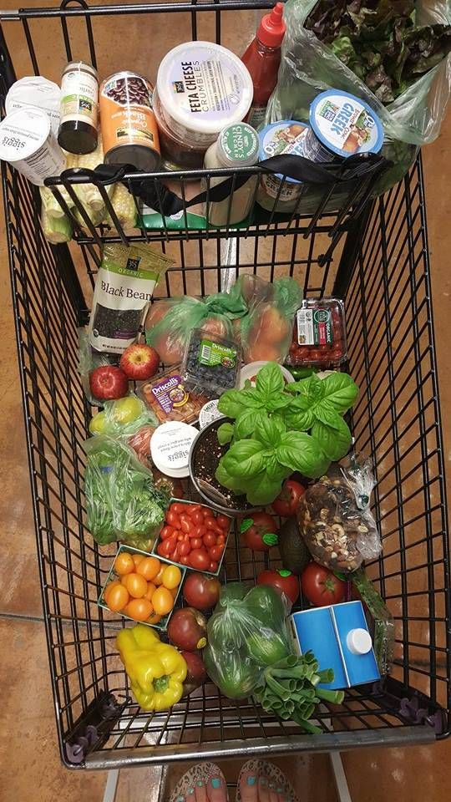
Business Problem and Objectives
The business problem for this project is Customer Segmentation Analysis.
The objective is to build a clustering model to segment the customers based on their purchase history.
The project aims to leverage the transactional data available with a retailer to equip the management to offer targeted advertisements for improving sales metrics for their existing set of customers.
The business problem is Customer Segmentation Analysis.
The objective is building a clustering model to segment the customer-based similarity. In other words, the project aims to identify relationships between items that people frequently buy together.

Slide 4
Executive Summary
Retailers are always looking for ways to increase their revenue, and one of the easiest ways to do that is by targeted marketing. Any business wishes to hold on to its most valuable customers (MVCs) while trying to evolve the other - less frequent/ one time customers/ window shoppers - into loyal and more valuable customers.
Hence, we ask through this project the following:
(i) How should we define our most valuable customers (MVC)?
(ii) What percentage of our customers are the most valuable customers?

Slide 5
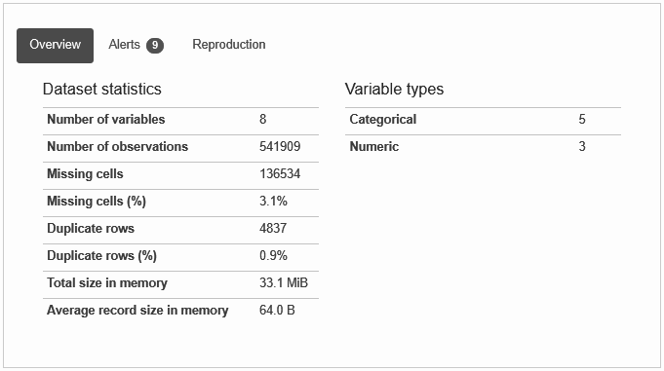
Introduction to Dataset
We will be using a transactions-based dataset which contains all the transactions occurring for a year for a UK-based, registered non-store online retail.
The company mainly sells various gift items. It has various attributes like the Quantity, Invoice number, Description of the product,Invoice date, Customer ID, Country, etc.
It is a large dataset with over 500,000 records.

Slide 6
Introduction to Features
Let's see the description of each column:
InvoiceNo: A unique identifier for the invoice. An invoice number shared across rows means that those transactions were performed in a single invoice (multiple purchases).
StockCode: Identifier for items contained in an invoice.
Description: Textual description of each of the stock item.
Quantity: The quantity of the item purchased.
InvoiceDate: Date of purchase.
UnitPrice: Value of each item.
CustomerID: Identifier for customer making the purchase.
Country: Country of customer/order destination.

Slide 7
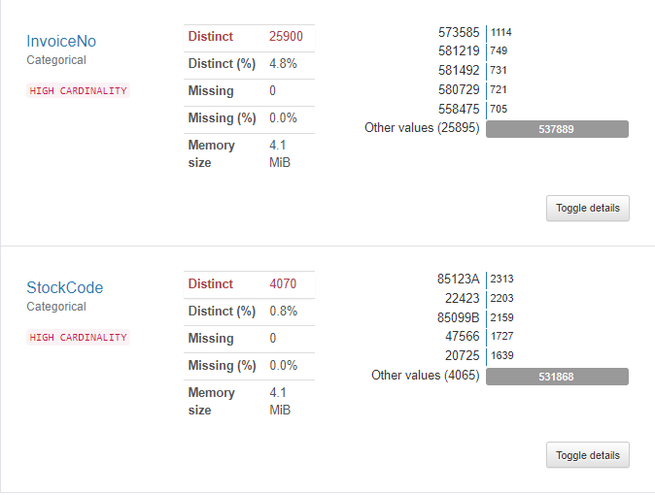

Slide 8
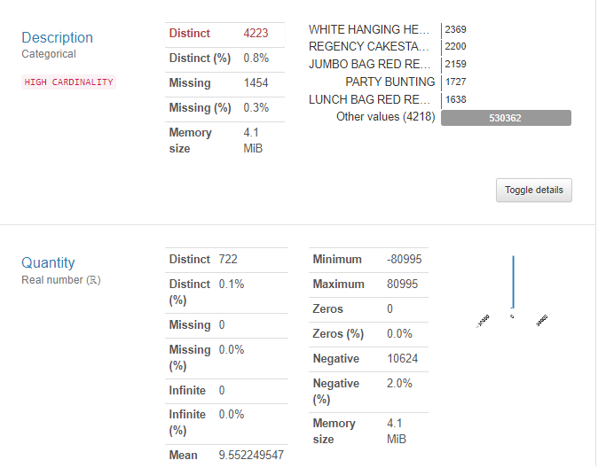

Slide 9
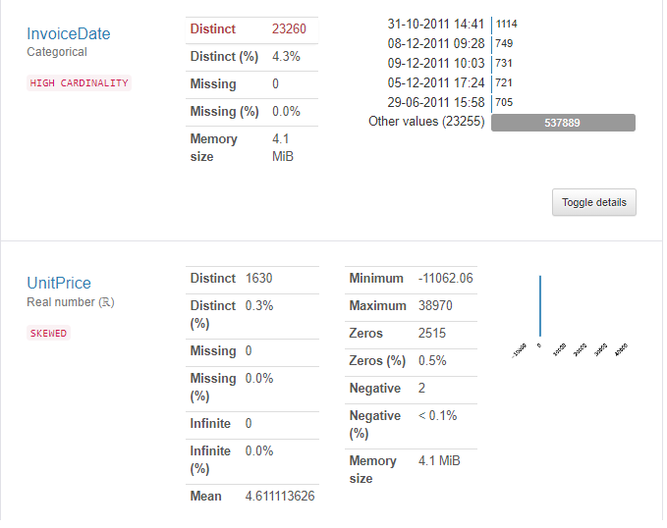

Slide 10
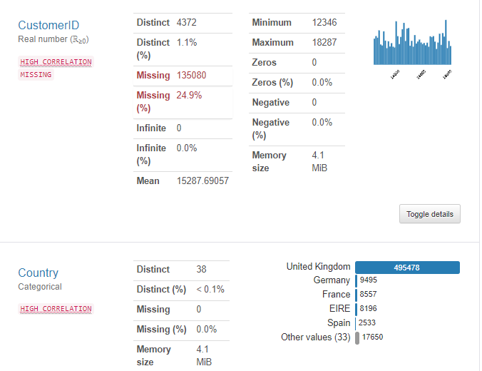

Slide 11
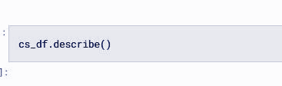
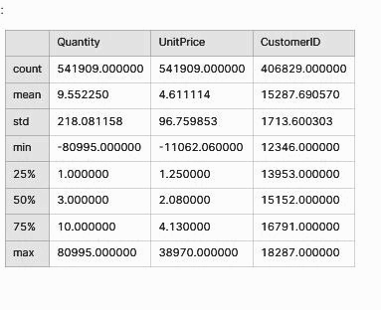
Standardizing variables
We can observe from the preceding output that Quantity and UnitPrice are having negative values, which may mean that we may have some return transactions in our data also.

Slide 12
Exploratory Data Analysis
Customers segmentation using RFM
RFM analysis is a marketing technique used to quantitatively rank and group customers to identify the best customers and perform targeted marketing campaigns.
There are three main factors that determine the buying behavior of customers: recency, frequency and monetary (RFM). The RFM model is used to segment customers on the basis of their buying patterns with respect to these three parameters.
Recency = the interval between the last action and today
Frequency = the number of actions between the user’s sign up date and today
Monetary value = the sum of revenue within the user’s lifetime

Slide 13
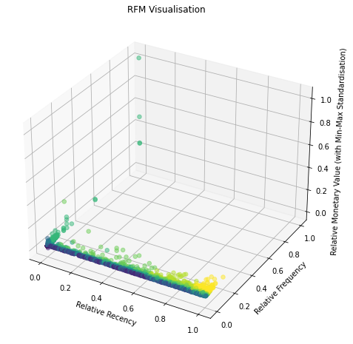
In bringing out the business value from the model output we found the following useful:
Convert absolute recency, frequency, and monetary values into relative ones to reduce the bias associated with the actual customer lifetime.
Relative parameters were obtained w.r.t. to lifetime of each particular customer.
Generate simple, heuristic business logic to deliver business value in a quick manner.

Slide 14
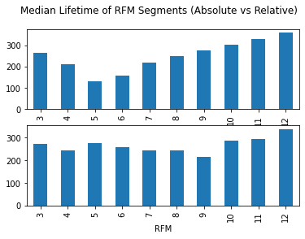
Once we obtain the scores of each individual dimension, we calculate the overall RFM score by summing up the three scores. The higher the overall RFM score, the more valuable the customer.
This method is easy to implement, yet it is prone to bias associated with the actual customer lifetime. To account for this bias, we would first calculate relative Recency, Frequency, and Monetary Value before calculating individual scores.
Then we would calculate the Frequency Score based on the Relative Frequency.

Slide 15
We have applied the RFM framework to this aggregate dataset and answer the following questions:
Is there a correlation between Recency, Frequency, and Monetary Value?
How should we define our most valuable customers (MVC)? What percentage of our customers are the most valuable customers?
Are we able to create distinguishing segments and design CRM campaigns accordingly to improve customer engagement and/or monetization?

Slide 16
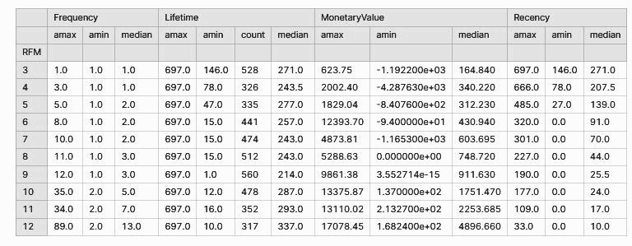
RFM Segmentation Results

Slide 17
Observations
This table answers our first two questions:
There is indeed a positive correlation across Recency, Frequency, and Monetary Value.
Our MVCs are those with a total RFM score of 11 and 12, i.e., they on average had more than 7 transactions, generated more than 2K in their lifetime, and had their last transaction within the last 2 weeks. Such customers account for ~16% of our total customer base.

Slide 18
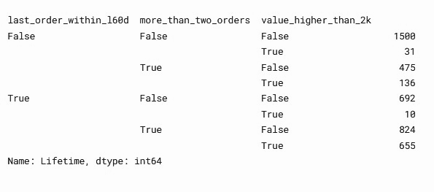
customer_data["last_order_within_l60d"] = customer_data["Recency"]<60 # Had transactions in the last 60 days
customer_data["more_than_two_orders"] = customer_data["Frequency"]>2 # Logged in more than twice
customer_data["value_higher_than_2k"] = customer_data["MonetaryValue"]>2000 # Sum of value higher than 2K
customer_data.groupby(["last_order_within_l60d", "more_than_two_orders", "value_higher_than_2k"]).count()["Lifetime"]

Slide 19
Based on the branching above, we have defined five final segments (with segment sizes in brackets):
High Engagement & High Value (count -15%, contribution - 52%) are those who had their last transactions in the last 2 months, made more than 2 transactions, and contributed more than 2K on average.
High Engagement & Low Value (19%) are those who are as active as Group1 but contributed less than 2K.
Recent Activity & Low Frequency (count -16%, contribution -6%) are those who had their last transactions in the last 2 months but made no more than 2 transactions. These customers also have a lower monetary value. Apparently, most customers in this group are recently acquired customers (their average lifetime is only 45 days).
“Old” Activity & High Frequency (14%) are those who did not have any transactions in the last 2 months. However, on average they had more than 2 transactions. These customers were very active at the beginning of their journey but are not that active recently. We need to find ways to re engage them.
Low Engagement & Low Value (count - 35%, contribution - 11%) are those who did not have any transactions in the last 2 months, made no more than 2 transactions, and contributed the lowest revenue.

Slide 20
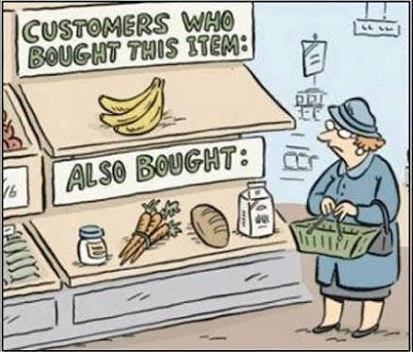
Are we able to create distinguishing segments and design CRM campaigns accordingly to improve customer engagement and/or monetization?
As for this question, yes we managed to create distinguishing segments (previous five) and
one use case can be to send this label to a CRM tool and use it for customized engagement communication. Take the final segments we generated above as one example: for Group 2 High Engagement & Low Value and Group 3 Recent Activity & Low Frequency we should focus on monetization by personalized recommendation while for Group 4 “Old” Activity & High Frequency we should try to re-engage them and bring them back to our website/application.

Slide 21
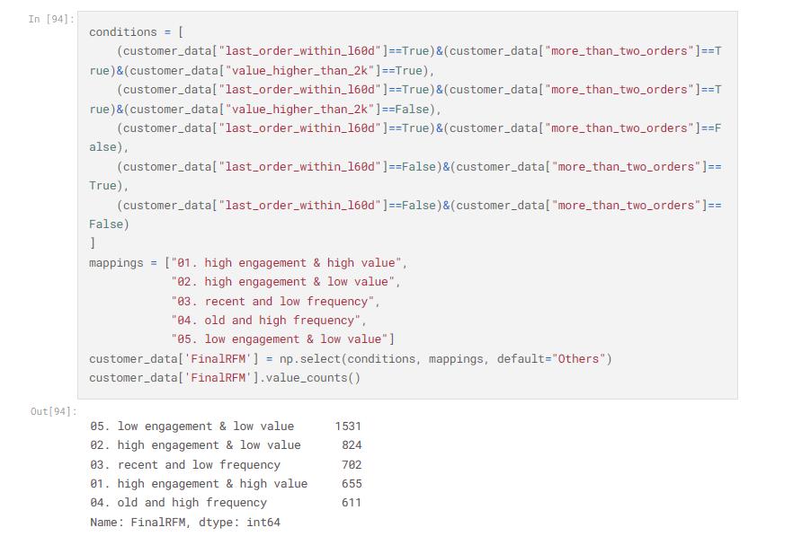

Slide 22
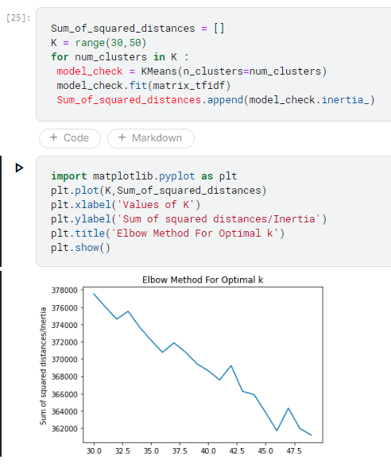
We further explored the possibility of text clustering on the “item description feature” to implement “upselling” technique with help of data. Although, ideal No. of clusters as shown below came out at “47”, but we proceeded with the next best value - 32 nos. of clusters for item type.

Slide 23
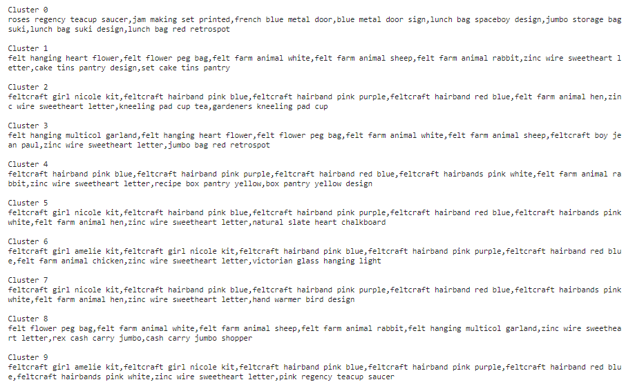
Cluster Samples - Upselling and Targeted Discounting

Slide 24
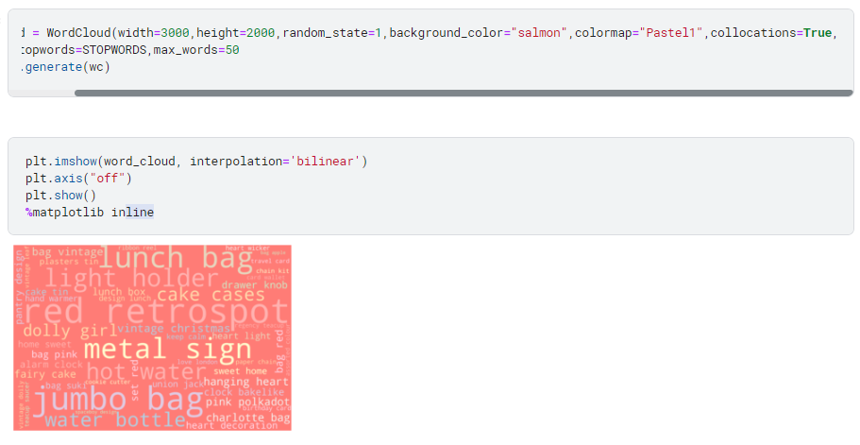
Word Cloud for 50 Most Frequent Words in Description

Slide 25
Business Recommendations
For respective segments,
High Engagement High Value - VIP tags, dedicated relationship manager, loyalty bonus
High Engagement Low Value - Improving inventory, email campaign for fresh arrivals, targeted discounts
Old and High Frequency - Email campaign, targeted discounts
Recent and Low Frequency - Improving inventory, email campaign for fresh arrivals, targeted discounts
Low Engagement Low Value - Email campaign, targeted discounts
Combined with features from other datasets we are able to design
targeted content and medium to reach individual customers and
maximize conversions.

Slide 26
Thank You

